Slide 1
Logistics Optimization for Delivery Routes using SQL :UPS Logistics
pRepared by - Ratan Ghanghoriya
Course Name –Data Science programe
Project Title - Logistics Optimization for Delivery Routes – UPS
https://www.loom.com/share/86fa42d3d8964e2196ccfcfd69b85e9e

Slide 2
Project Objective
To analyze delivery performance.
Identify delays route.
Evaluate warehouse efficiency.
Measure delivery agent performance.
Recommended business improvement

Slide 3
Dataset Used
Tables Used:
1. orders – 300 records
2. routes – 20 records
3. delivery agents -50 records
4. warehouses -10 records
5. shipment tracking - 1040 records

Slide 4


-- =========================-- TASK 1: DATA CLEANING =========================
1 . Find duplicate Order_ID
;
2 . Replace NULL Traffic_Delay_Min with route average
Business Insight:
The Orders table has unique Order IDs. This shows that there are no duplicate transactions, so the data is accurate and reliable for reporting.
Recommendation:
No action is required. Keep the Order IDs unique when importing new data in the future.

Slide 5
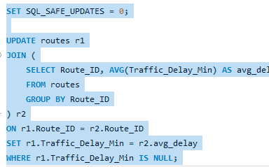
TASK 1 TO CONTINUE…..

Slide 6
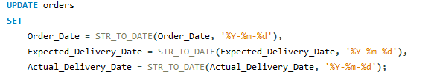
TASK 1 TO CONTINUE…..
Business Insight:
The Routes dataset has complete traffic delay information. There are no missing values, so the data is reliable for traffic analysis.
Recommendation:
No action is required. Continue checking new data to make sure it stays complete and accurate.
3. Convert date columns into YYYY-MM-DD format

Slide 7
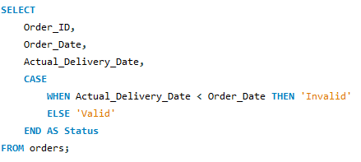
TASK 1 TO CONTINUE…..
Business Insight:
Using the same date format makes the data consistent and helps avoid errors in date calculations, monthly reports, delivery delay analysis, and KPI reporting.
Recommendation:
Use the YYYY-MM-DD date format for all future data imports to keep the data accurate and avoid reporting errors.
4. Add flag column for invalid data

Slide 8
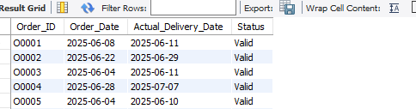
TASK 1 TO CONTINUE…..
Business Insight:
The dataset passed the date validation check. No invalid delivery dates were found, so the data is reliable for delivery delay analysis, KPI calculations, and performance reporting.
Recommendation:
Use automatic date validation during data entry or data import (ETL) to keep future records accurate and maintain data quality

Slide 9
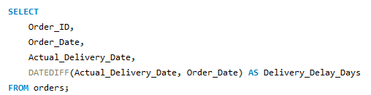
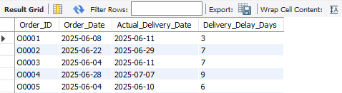
TASK 2: DELIVERY DELAY ANALYSIS
1. Calculate delivery delay for each order (in days)
Business Insight:
The delivery delay has been calculated for each order. This helps identify orders that took longer to deliver. High delivery delays may show problems in the delivery process.

Slide 10
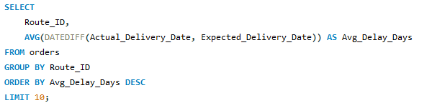
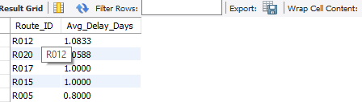
TASK 2 TO CONTINUE…..
Recommendation:
Regularly monitor orders with high delivery delays. Check their routes, traffic conditions, and warehouse processing time to help reduce future delays.
2. Top 10 delayed routes based on average delay

Slide 11
Top 10 Delayed Routes (Average Delay in Days)
Average Delay (Days)

Slide 12
TASK 2 TO CONTINUE…..
Business Insight
Route R012 has the highest average delivery delay (1.08 days).
Route R020 has the second-highest average delay (1.06 days).
These routes take longer than other routes and should be prioritized for improvement.
Recommendation
Optimize delivery schedules.
Monitor traffic conditions on these routes.
Improve warehouse coordination.
Review route planning regularly to reduce delivery delays.

Slide 13
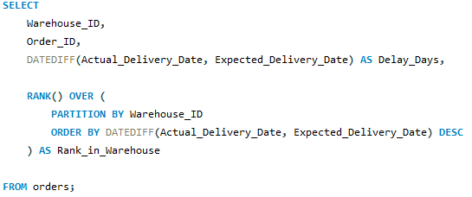
TASK 2 TO CONTINUE…..
Result
Result: the most in each warehouse.
Business Insight:
The top 10 routes have the highest average delivery delays. These routes may have regular traffic or delivery problems and could be causing more late deliveries, which can affect customer satisfaction
Recommendation:
Check these routes for traffic, warehouse processing time, and delivery schedules. Improving these routes can help reduce delivery delays and make the delivery process more efficient.
3. Rank all orders by delay within each warehouse

Slide 14
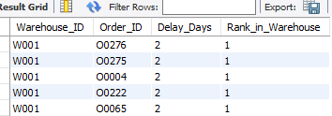
TASK 2 TO CONTINUE…..
Business Insight:
The orders are ranked by delivery delay within each warehouse. This helps identify the most delayed orders in every warehouse and shows where delivery performance needs improvement.
Recommendation:
Regularly review the highest-ranked delayed orders in each warehouse. Find the reasons for the delays and improve warehouse operations and delivery planning to reduce future delays.

Slide 15
TASK 2 TO CONTINUE…..
Business Insight:
Routes R005 and R004 have the highest average delivery time. This means deliveries on these routes take longer than others and may have traffic or delivery process issues.
Recommendation:
Review these routes for traffic, delivery schedules, and operational issues. Improving these routes can help reduce delivery time and increase customer satisfaction.

Slide 16
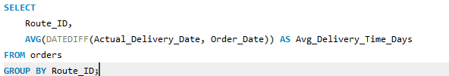
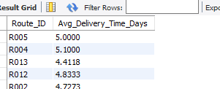
TASK 3: ROUTE OPTIMIZATION
1. Average delivery time for each route
;

Slide 17
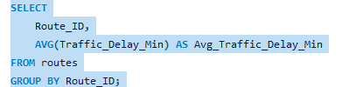
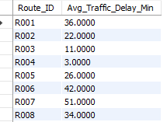
TASK 3 TO CONTINUE…..
2 . Average traffic delay for each route
Business Insight: Routes with high average traffic delay experience frequent congestion, increasing delivery time and transportation costs.
Recommendation
Optimize delivery schedules during peak traffic hours and consider alternate routes.

Slide 18
TASK 3 TO CONTINUE…..

Slide 19
TASK 3 TO CONTINUE…..
Business Insight
Route R014 has the highest average traffic delay (about 58 minutes).
Routes R007 and R009 also experience high traffic delays.
These routes are more likely to contribute to late deliveries.
Recommendation
Optimize delivery schedules during peak traffic hours.
Use alternate routes where possible.
Monitor traffic conditions in real time.

Slide 20
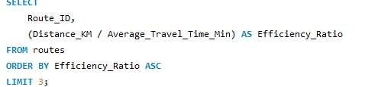
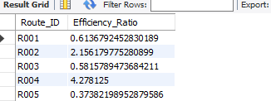
TASK 3 TO CONTINUE…..
Business Insight:
A low efficiency ratio means the route takes more time to cover a shorter distance. This may show that the route is not operating efficiently.
Recommendation:
Check these routes for traffic, road conditions, and delivery schedules. Fixing these issues can improve route efficiency and reduce delivery time.
3. Efficiency ratio (Distance / Time).
Result:
Efficiency ratio is calculated using Distance divided by Travel Time.
This helps to check how efficiently each route is performing.
Routes with low efficiency ratio may need better route planning and improvement.

Slide 21
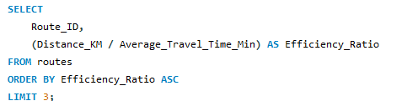

TASK 3 TO CONTINUE…..
4. Find 3 routes with worst efficiency ratio
Business Insight:
A low efficiency ratio means the route takes more time to cover a shorter distance. This may show that the route is not operating efficiently.
Recommendation:
Check these routes for traffic, road conditions, and delivery schedules. Fixing these issues can improve route efficiency and reduce delivery time.

Slide 22

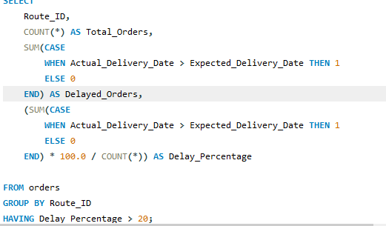
TASK 3 TO CONTINUE…..
5.Find routes with more than 20% delayed shipments

Slide 23
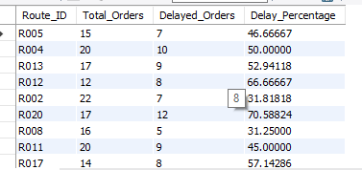
TASK 3 TO CONTINUE…..
Business Insight:
Routes with more than 20% delayed shipments have frequent delivery delays. This may be caused by traffic, poor route planning, or warehouse processing issues.
Recommendation:
Focus on these routes first. Improve route planning, monitor traffic, and update delivery schedules to reduce delays and improve customer satisfaction.

Slide 24
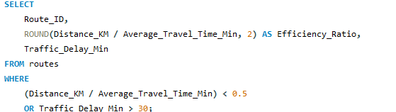
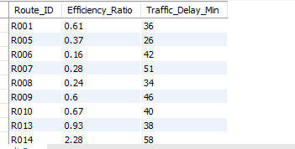
TASK 3 TO CONTINUE…..
6. Recommend routes for optimization

Slide 25
TASK 3 TO CONTINUE…..
Business Insight:
Routes with a low efficiency ratio (less than 0.5) and traffic delays of more than 30 minutes are the least efficient. These routes are more likely to have delivery delays and higher transportation costs.
Recommendation:
Focus on improving these routes by using better routes, planning delivery schedules, and monitoring traffic during busy hours. This can help reduce delivery delays and improve overall efficiency.

Slide 26
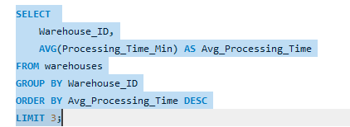

TASK 4 :Warehouse Performance
1. Top 3 warehouses with highest average processing time
Business Insight:
Warehouses W010, W009, and W007 have the highest average processing times. This means they take longer to process orders, which may cause slower dispatch and delivery delays.
Recommendation:
Improve staffing, automate warehouse tasks, and make inventory handling more efficient. This can help reduce processing time and improve delivery performance.

Slide 27
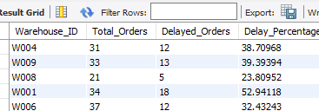
TASK 4 TO CONTINUE…..
2. Calculate total shipments vs delayed shipments for each warehouse.
SELECT Warehouse_ID, COUNT(*) AS Total_Orders, SUM( CASE WHEN Actual_Delivery_Date > Expected_Delivery_Date THEN 1 ELSE 0 END ) AS Delayed_Orders, ROUND( SUM( CASE WHEN Actual_Delivery_Date > Expected_Delivery_Date THEN 1 ELSE 0 END ) * 100.0 / COUNT(*), 2 ) AS Delay_PercentageFROM ordersGROUP BY Warehouse_ID;
Business Insight:
Warehouses with a high percentage of delayed shipments may have problems in processing or dispatch. These delays can affect customer satisfaction.
Recommendation:
Improve processing speed and delivery planning in warehouses with high delay percentages. This can help reduce delays and improve customer satisfaction.

Slide 28
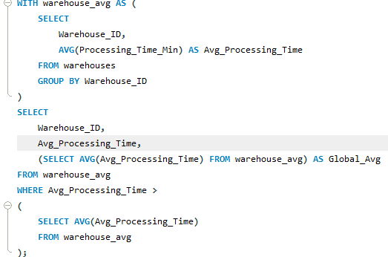
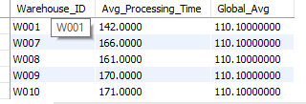
TASK 4 TO CONTINUE…..
3. Use CTEs to identify warehouses where average delay exceeds the global average delay.
Rank agents (per route) by On-Time Delivery Percentage

Slide 29
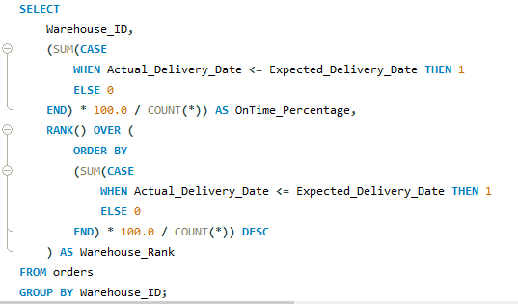
TASK 4 TO CONTINUE…..
Business Insight:
Warehouses with processing times higher than the overall average are taking longer to process orders. These warehouses may be causing delivery delays and reducing overall efficiency.
Recommendation:
Improve the workflow, increase staff if needed, and automate repetitive tasks in these warehouses. This can help speed up order processing and improve delivery performance.
3. Rank all warehouses based on on-time delivery percentage

Slide 30
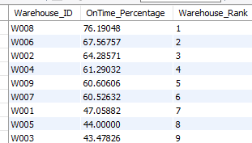
TASK 4 TO CONTINUE…..
Business Insight:
The warehouses were ranked based on their on-time delivery percentage. W008 has the highest on-time delivery rate (76.19%), showing better delivery performance than the other warehouses.
Recommendation:
Study the processes used by W008 and apply the same best practices in other warehouses to improve their on-time delivery performance.

Slide 31
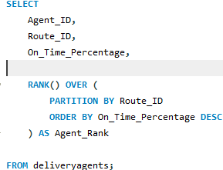
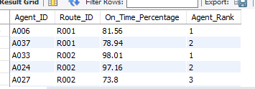
TASK 5: Delivery Agent Performance
Rank agents (per route) by On-Time Delivery Percentage

Slide 32
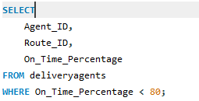
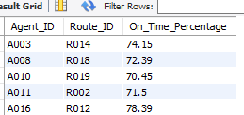
TASK 5 TO CONTINUE…..
Business Insight:
Delivery agents are ranked by their on-time delivery percentage for each route. Some routes have top-performing agents, while others have agents with lower on-time delivery rates who may need support or training.
Recommendation:
Use the working methods of the best-performing agents as an example. Provide training and balance the workload for lower-performing agents to improve delivery performance.
2. Find agents with On-Time Percentage less than 80%

Slide 33
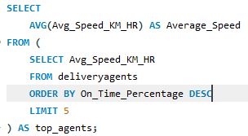
TASK 5 TO CONTINUE…..
Business Insight:
Nine delivery agents have an on-time delivery rate below 80%. Agent A010 has the lowest performance at 70.45%, so these agents may need extra support to improve.
Recommendation:
Provide training to these agents, review their delivery assignments, and check their performance regularly. They can also learn from the working methods of top-performing agents to improve their on-time delivery rate.
3. Compare Average Speed of Top 5 Agents

Slide 34

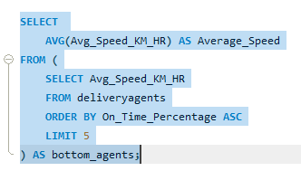
TASK 5 TO CONTINUE…..
Business Insight:
The top 5 delivery agents have an average speed of 60 km/hr. This shows they maintain good travel speed and deliver orders on time.
Recommendation:
Study the working methods and route planning of these top-performing agents. Use their best practices to train other delivery agents and improve overall delivery performance.
4. Compare Average Speed of Bottom 5 Agents

Slide 35

TASK 5 TO CONTINUE…..
Business Insight:
The top 5 delivery agents have an average speed of 60.00 km/hr, while the bottom 5 agents have an average speed of 56.80 km/hr. This shows that better-performing agents travel slightly faster and are more likely to deliver orders on time.
Recommendation:
Study the route planning and working methods of the top-performing agents. Provide training and better route planning for lower-performing agents to help improve their speed and on-time delivery while ensuring safe driving.
5. Suggest training or workload balancing strategies for low-performing agents based on insights.
Business Insight:
Delivery agents with less than 80% on-time delivery performance are performing worse than other agents. The Top 5 agents have an average speed of 60.00 km/hr, while the Bottom 5 agents have an average speed of 56.80 km/hr. This shows that better route planning and work practices may help improve delivery performance.
Recommendation:
Provide training on route planning, time management, and efficient delivery methods for low-performing agents. Balance workloads based on each agent's capacity, and encourage top-performing agents to share their best practices. Regular performance reviews and feedback can help improve on-time delivery performance.

Slide 36
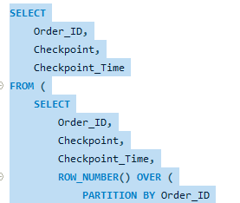
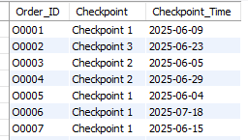
Task 6: Shipment Tracking Analytics
1.For each shipment, display the latest status (Delivered, In Transit, or Returned) along with the latest Delivery_Date1
Business Insight:
The latest checkpoint shows the current status of each shipment. It helps track where the shipment is and identify orders that may be delayed at a checkpoint.
Recommendation:
Regularly monitor shipments that stay at the same checkpoint for a long time. Check the reason for the delay and improve coordination between logistics hubs to move shipments faster.

Slide 37
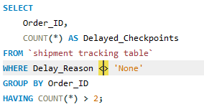
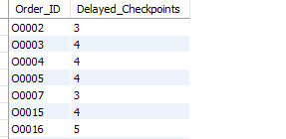
TASK 6 TO CONTINUE…..
2.Identify routes where the majority of shipments are still “In Transit” or “Returned”.
Business Insight:
Some orders have delays at more than two checkpoints during delivery. Order O0016 has the highest number of delayed checkpoints (5), while O0003, O0004, O0005, and O0015 each have 4 delayed checkpoints. These orders are more likely to be delivered late.
Recommendation:
Regularly monitor orders with multiple delayed checkpoints. Find the reasons for the repeated delays and improve coordination between logistics hubs to reduce delays and ensure on-time delivery.

Slide 38
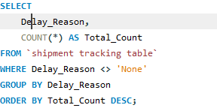

TASK 6 TO CONTINUE…..
3.Find the most frequent delay reasons (if available in delay-related columns or flags )
Business Insight:
Sorting Delay is the most common reason for shipment delays (272 times). It is followed by Weather (263) and Traffic (247). This shows that warehouse sorting causes more delays than external factors.
Recommendation:
Improve the warehouse sorting process by using automation, better staff planning, and barcode scanning. Also, monitor weather and traffic conditions to help reduce delays caused by external factors.

Slide 39
TASK 6 TO CONTINUE…..

Slide 40
TASK 6 TO CONTINUE…..
Business Insight
Sorting Delay is the most frequent delay reason (272 cases).
Weather caused 263 delays.
Traffic caused 247 delays.
Internal sorting issues contribute slightly more delays than external factors.
Recommendation
Improve warehouse sorting using automation and barcode scanning.
Monitor weather and traffic conditions to reduce external delays.
Use real-time alerts for shipments affected by operational bottlenecks.

Slide 41
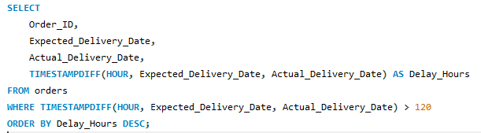
TASK 6 TO CONTINUE…..
Business Insight:
No orders had a delivery delay of more than 120 hours (5 days). This shows that the delivery process is working well and is preventing very long delays.
Recommendation:
Continue monitoring delivery performance and use automatic delay alerts to identify delayed shipments early. This can help prevent future orders from exceeding the 120-hour limit.

Slide 42
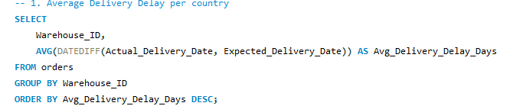
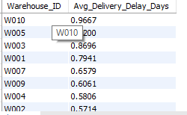
Task 7: Advanced KPI Reporting
1.Average Delivery Delay per Source_Country

Slide 43
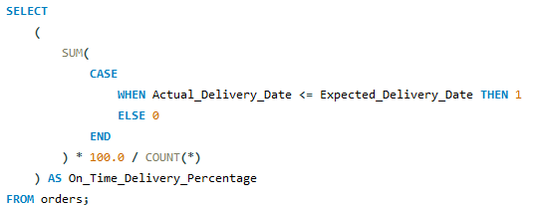
TASK 7 TO CONTINUE…..
Business Insight:
Warehouse W010 has the highest average delivery delay (0.97 days), followed by W005 (0.92 days) and W003 (0.87 days). These warehouses take longer to deliver orders and may need improvements in their operations.
Recommendation:
Review the dispatch process, warehouse operations, and staffing at W010, W005, and W003. Improving these areas can help reduce delivery delays and improve customer satisfaction.
2.On-Time Delivery % = (Total On-Time Deliveries / Total Deliveries) * 100.

Slide 44

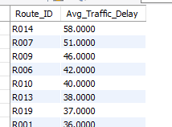
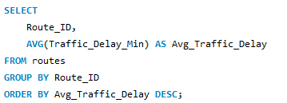
TASK 7 TO CONTINUE…..
3.Average Delay (in hours) per Route_ID

Slide 45
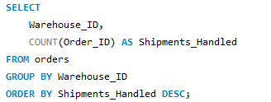
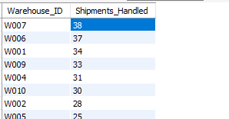
TASK 7 TO CONTINUE…..
4. Warehouse Utilization % = (Shipments_Handled / Capacity_per_day) * 100.

Slide 46
TASK 7 TO CONTINUE…..
Business Insight:
Warehouse W007 handled the highest number of shipments (38), followed by W006 (37) and W001 (34). These warehouses have a higher workload and may need extra support during busy periods.
Recommendation:
Monitor these high-workload warehouses regularly and balance shipments across warehouses. If the workload increases, add staff or improve warehouse operations to reduce processing delays.

Slide 47
TASK 7 TO CONTINUE…..

Slide 48
TASK 7 TO CONTINUE…..
Business Insight:
Warehouse W007 handled the highest number of shipments (38), followed by W006 (37) and W001 (34). These warehouses have a higher workload and may need extra support during busy periods.
Recommendation:
Balance shipments across warehouses, increase staff or use automation in high-workload warehouses, and regularly monitor warehouse capacity to help prevent processing delays.

Slide 49
Key Insights & Business Recommendations
Key Insights
Overall, 56% of deliveries were on time.
Route R012 has the highest delivery delay.
Route R014 has the highest traffic delay.
Warehouse W007 handled the most shipments.
Sorting Delay is the biggest reason for shipment delays.
Some delivery agents have an on-time delivery rate below 80%.
Business Recommendations
Improve planning for routes with high delays.
Make warehouse work faster and more efficient.
Improve the sorting process to reduce delays.
Give training to low-performing delivery agents.
Share the workload between warehouses.
Track deliveries regularly to reduce delays.

Slide 50
Task 8: PPT Presentation and Video
https://www.loom.com/share/86fa42d3d8964e2196ccfcfd69b85e9e

Slide 51
Thank you!
Thank you for your time and attention.

